Slide 1
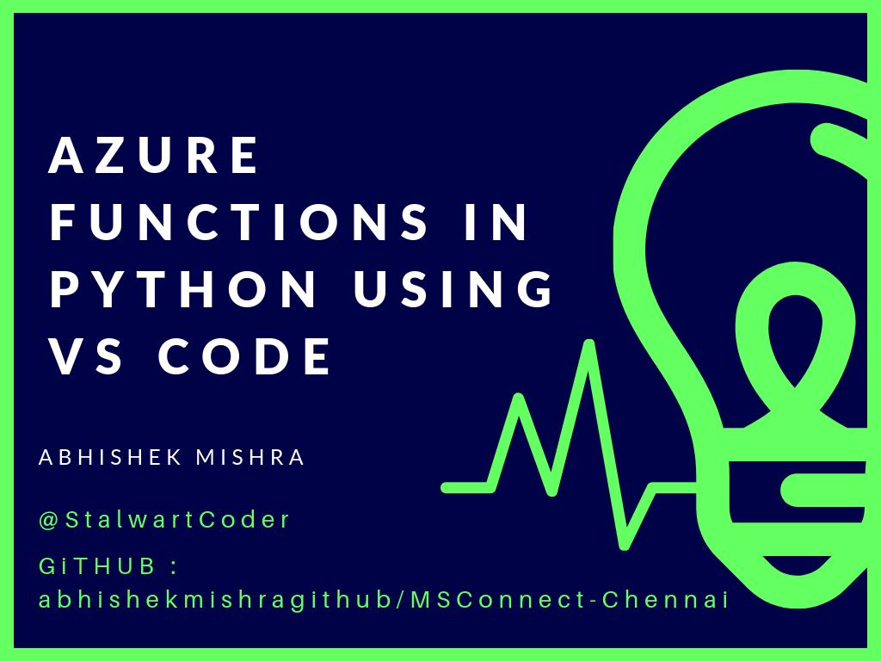

Slide 2
Resources :
https://docs.microsoft.com/en-us/azure/azure-functions/functions-create-first-function-
https://github.com/Azure/azure-functions-python-worker
https://r-vm.com/python-on-azure-functions
https://github.com/abhishekmishragithub/MSConnect-Chennai
Updated Repo and blog – Coming Soon….

Slide 3
https://www.microsoft.com/en-us/connectevent/ OR https://azure.microsoft.com/en-in/connect/
MS Connect() 2018 Session & Resources:

